Slide 1
11
Fundamentals of the Nervous System and Nervous Tissue: Part A

Slide 2
The Nervous System
Master controlling and communicating system of body
Cells communicate via electrical and chemical signals
  Rapid and specific
  Usually cause almost immediate responses

Slide 3
Functions of the Nervous System
Sensory input
  Information gathered by sensory receptors about internal and external changes
Integration
  Processing and interpretation of sensory input
Motor output
  Activation of effector organs (muscles and glands) produces a response

Slide 4
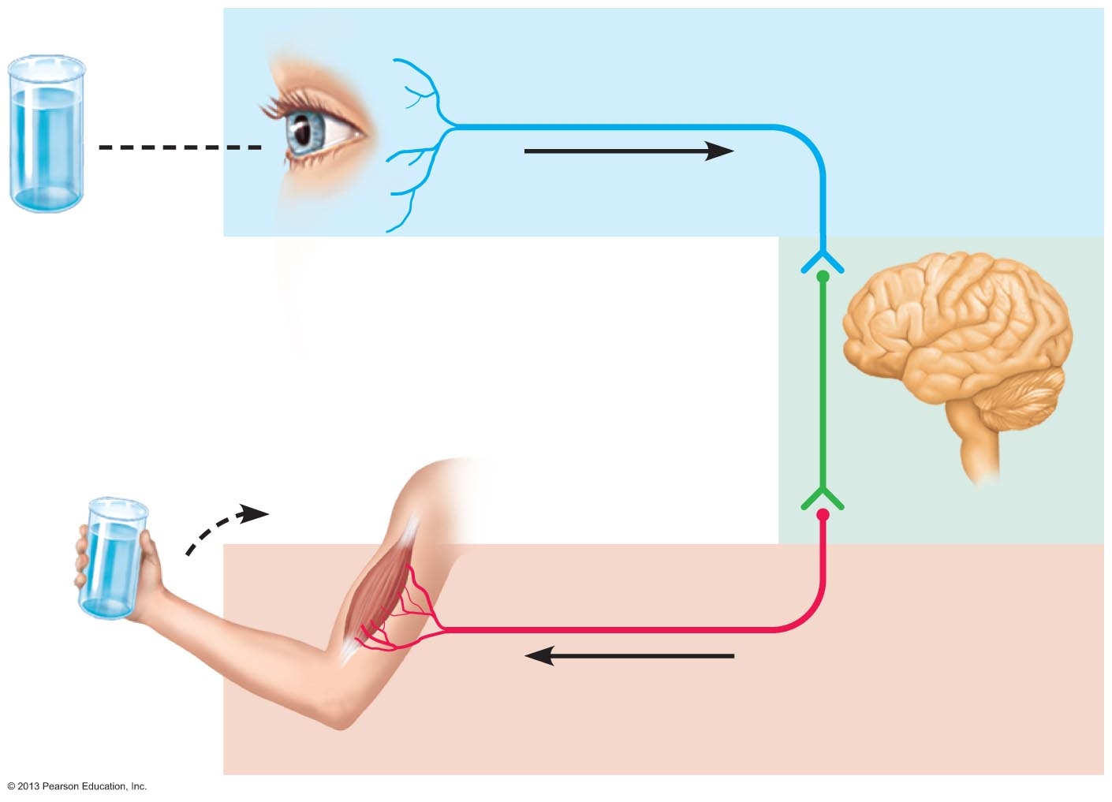
Figure 11.1 The nervous system’s functions.
Sensory input
Integration
Motor output

Slide 5
Divisions of the Nervous System
Central nervous system (CNS)
  Brain and spinal cord of dorsal body cavity
  Integration and control center
    Interprets sensory input and dictates motor output
Peripheral nervous system (PNS)
  The portion of the nervous system outside CNS
  Consists mainly of nerves that extend from brain and spinal cord
    Spinal nerves to and from spinal cord
    Cranial nerves to and from brain

Slide 6
Peripheral Nervous System (PNS)
Two functional divisions
  Sensory (afferent) division
    Somatic sensory fibers—convey impulses from skin, skeletal muscles, and joints to CNS
    Visceral sensory fibers—convey impulses from visceral organs to CNS
  Motor (efferent) division
    Transmits impulses from CNS to effector organs
      Muscles and glands
    Two divisions
      Somatic nervous system
      Autonomic nervous system

Slide 7
Motor Division of PNS:
Somatic Nervous System
Somatic motor nerve fibers
Conducts impulses from CNS to skeletal muscle
Voluntary nervous system
  Conscious control of skeletal muscles

Slide 8
Motor Division of PNS:
Autonomic Nervous System
Visceral motor nerve fibers
Regulates smooth muscle, cardiac muscle, and glands
Involuntary nervous system
Two functional subdivisions
  Sympathetic
  Parasympathetic
  Work in opposition to each other

Slide 9
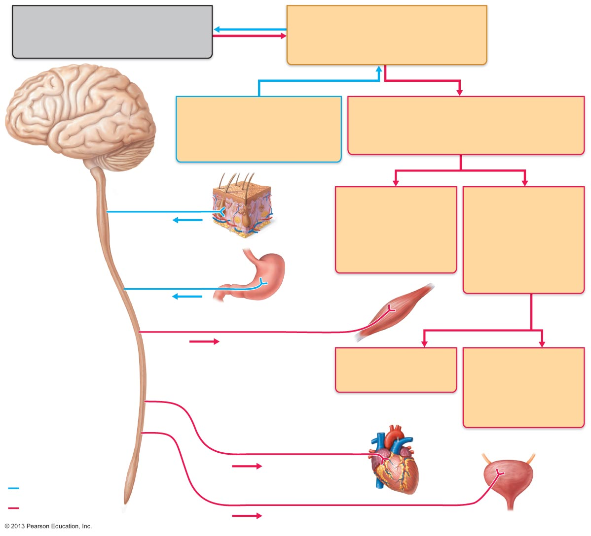
Figure 11.2 Levels of organization in the nervous system.
Central nervous system (CNS)
Peripheral nervous system (PNS)
Brain and spinal cord
Cranial nerves and spinal nerves
Integrative and control centers
Communication lines between the CNS
and the rest of the body
Sensory (afferent) division
Motor (efferent) division
Somatic and visceral sensory
nerve fibers
Motor nerve fibers
Conducts impulses from
receptors to the CNS
Conducts impulses from the CNS
to effectors (muscles and glands)
Somatic sensory fiber
Skin
Somatic nervous
system
Autonomic nervous
system (ANS)
Somatic motor
(voluntary)
Visceral motor
(involuntary)
Conducts impulses
from the CNS to
skeletal muscles
Conducts impulses
from the CNS to
cardiac muscles,
smooth muscles,
and glands
Visceral sensory fiber
Stomach
Skeletal
muscle
Motor fiber of somatic nervous system
Sympathetic division
Parasympathetic
division
Mobilizes body systems
during activity
Conserves energy
Promotes house-
keeping functions
during rest
Sympathetic motor fiber of ANS
Heart
Structure
Function
Sensory (afferent)
division of PNS
Parasympathetic motor fiber of ANS
Bladder
Motor (efferent)
division of PNS

Slide 10
Histology of Nervous Tissue
Highly cellular; little extracellular space
  Tightly packed
Two principal cell types
  Neuroglia – small cells that surround and wrap delicate neurons
  Neurons (nerve cells)—excitable cells that transmit electrical signals

Slide 11
Histology of Nervous Tissue: Neuroglia
Astrocytes (CNS)
Microglial cells (CNS)
Ependymal cells (CNS)
Oligodendrocytes (CNS)
Satellite cells (PNS)
Schwann cells (PNS)

Slide 12
Astrocytes
Most abundant, versatile, and highly branched glial cells
Cling to neurons, synaptic endings, and capillaries
Functions include
  Support and brace neurons
  Play role in exchanges between capillaries and neurons
  Guide migration of young neurons
  Control chemical environment around neurons
  Respond to nerve impulses and neurotransmitters
  Influence neuronal functioning
    Participate in information processing in brain

Slide 13
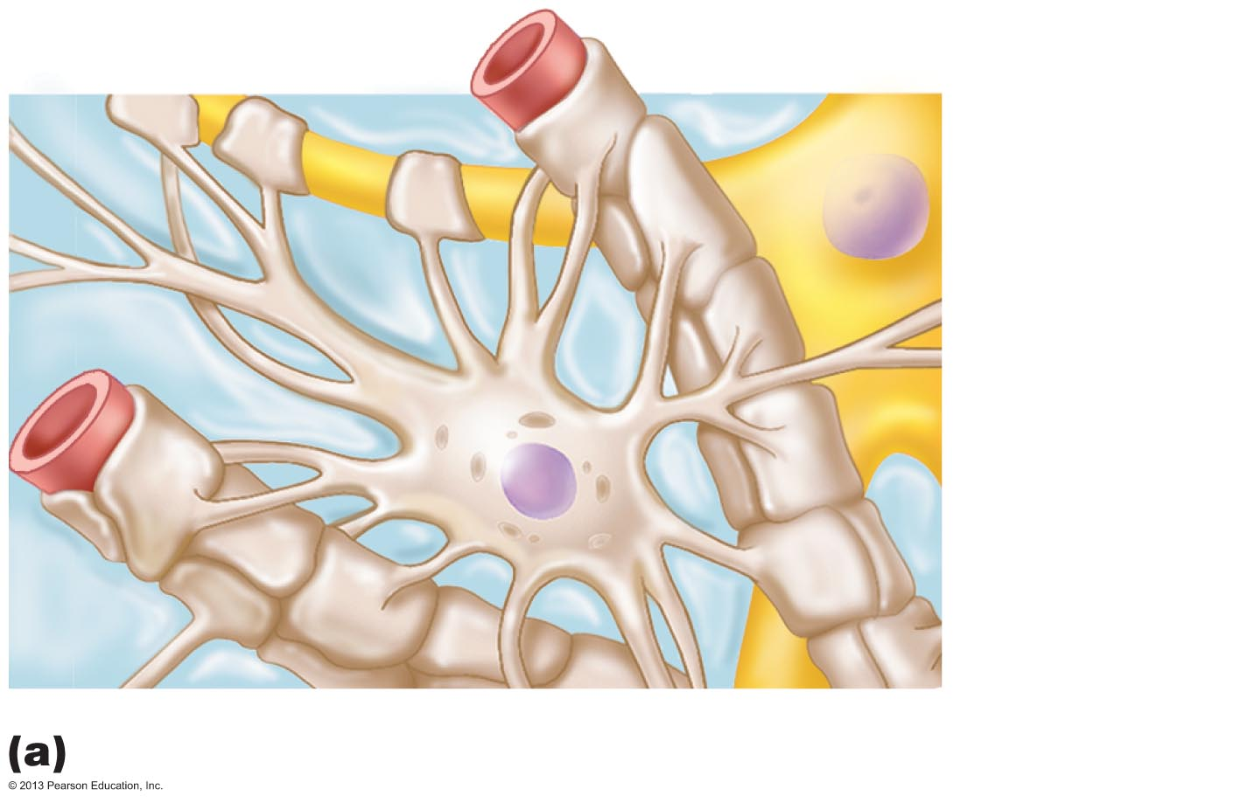
Figure 11.3a Neuroglia.
Capillary
Neuron
Astrocyte
Astrocytes are the most abundant CNS neuroglia.

Slide 14
Microglial Cells
Small, ovoid cells with thorny processes that touch and monitor neurons
Migrate toward injured neurons
Can transform to phagocytize microorganisms and neuronal debris

Slide 15
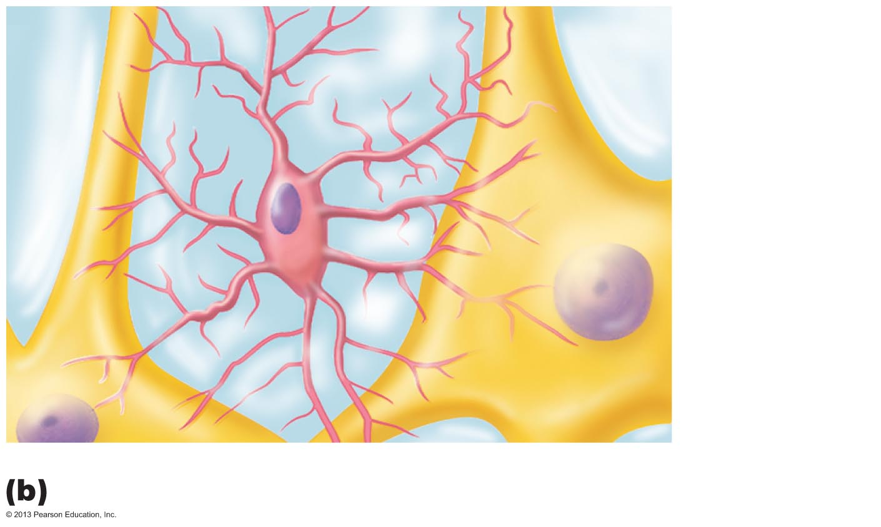
Figure 11.3b Neuroglia.
Neuron
Microglial
cell
Microglial cells are defensive cells in the CNS.

Slide 16
Ependymal Cells
Range in shape from squamous to columnar
May be ciliated
  Cilia beat to circulate CSF
Line the central cavities of the brain and spinal column
Form permeable barrier between cerebrospinal fluid (CSF) in cavities and tissue fluid bathing CNS cells

Slide 17
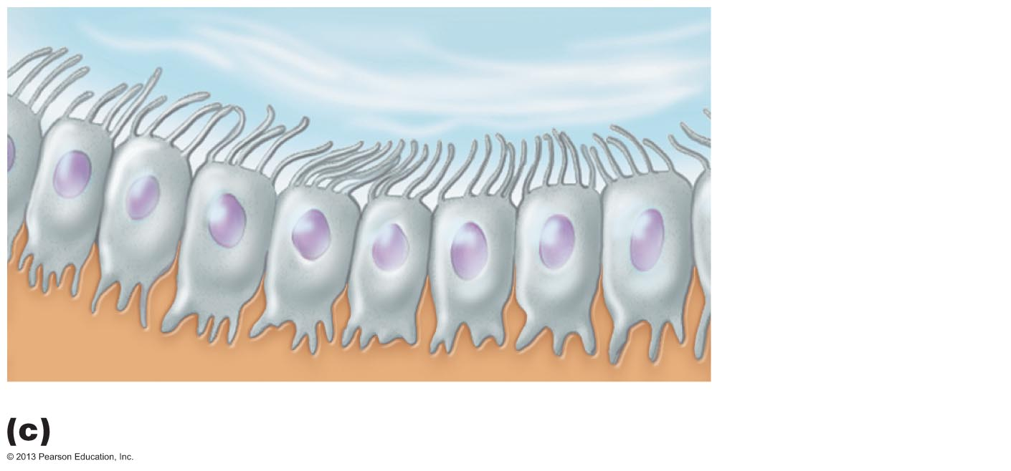
Figure 11.3c Neuroglia.
Fluid-filled cavity
Cilia
Ependymal
cells
Brain or
spinal cord
tissue
Ependymal cells line cerebrospinal fluid–filled cavities.

Slide 18
Oligodendrocytes
Branched cells
Processes wrap CNS nerve fibers, forming insulating myelin sheaths thicker nerve fibers

Slide 19
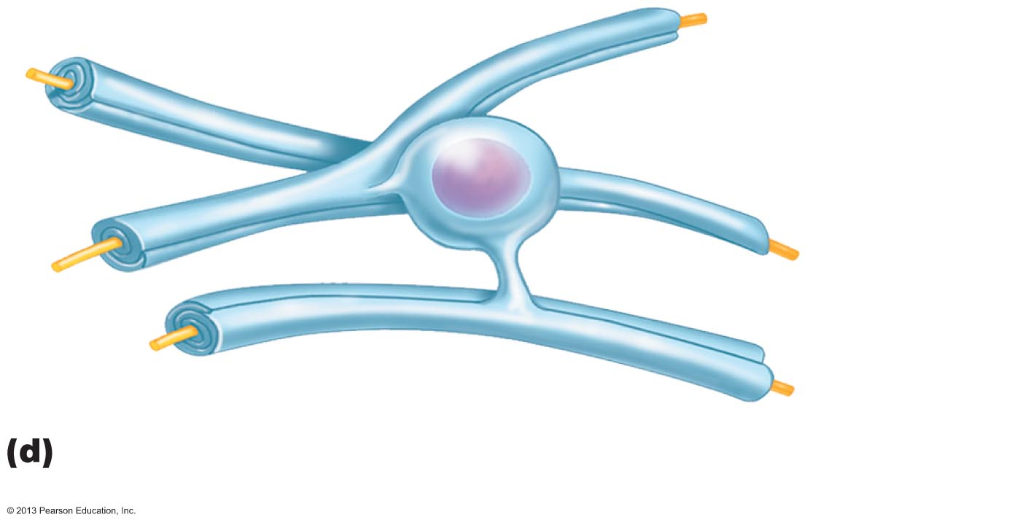
Figure 11.3d Neuroglia.
Myelin sheath
Process of
oligodendrocyte
Nerve
fibers
Oligodendrocytes have processes that form myelin
sheaths around CNS nerve fibers.

Slide 20
Satellite Cells and Schwann Cells
Satellite cells
  Surround neuron cell bodies in PNS
  Function similar to astrocytes of CNS
Schwann cells (neurolemmocytes)
  Surround all peripheral nerve fibers and form myelin sheaths in thicker nerve fibers
    Similar function as oligodendrocytes
  Vital to regeneration of damaged peripheral nerve fibers

Slide 21
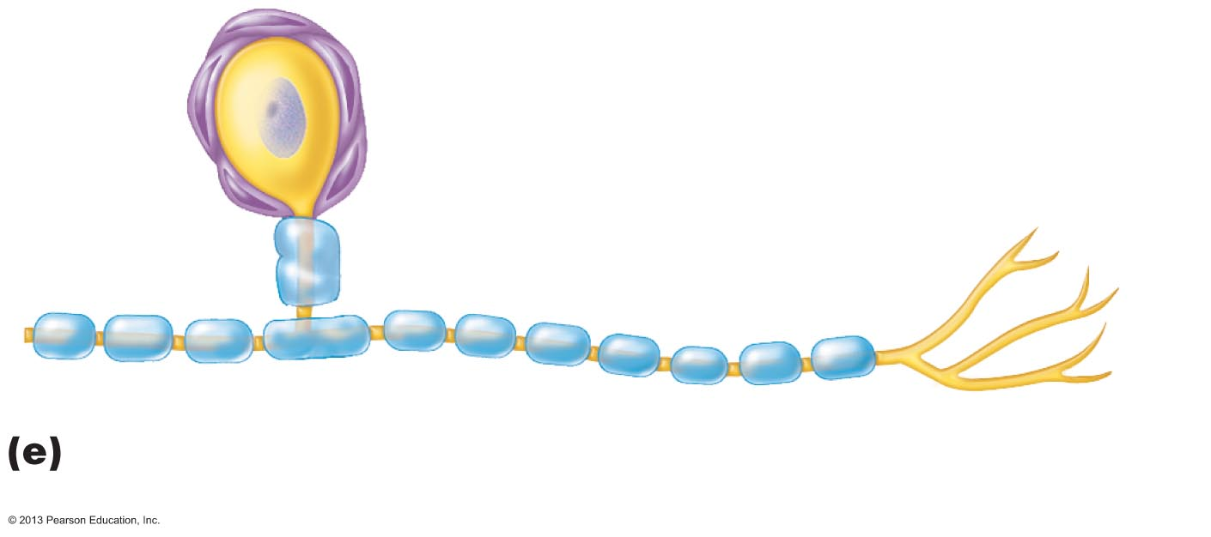
Figure 11.3e Neuroglia.
Satellite
cells
Cell body of neuron
Schwann cells
(forming myelin sheath)
Nerve fiber
Satellite cells and Schwann cells (which form myelin)
surround neurons in the PNS.

Slide 22
Neurons
Structural units of nervous system
Large, highly specialized cells that conduct impulses
Extreme longevity (→ 100 years or more)
Amitotic—with few exceptions
High metabolic rate—requires continuous supply of oxygen and glucose
All have cell body and one or more processes

Slide 23
Neuron Cell Body (Perikaryon or Soma)
Biosynthetic center of neuron
  Synthesizes proteins, membranes, and other chemicals
  Rough ER (chromatophilic substance or Nissl bodies)
    Most active and best developed in body
Spherical nucleus with nucleolus
Some contain pigments
In most, plasma membrane part of receptive region
Most neuron cell bodies in CNS
  Nuclei – clusters of neuron cell bodies in CNS
Ganglia – lie along nerves in PNS

Slide 24
Neuron Processes
Armlike processes extend from body
CNS
  Both neuron cell bodies and their processes
PNS
  Chiefly neuron processes
Tracts
  Bundles of neuron processes in CNS
Nerves
  Bundles of neuron processes in PNS
Two types of processes
  Dendrites
  Axon

Slide 25
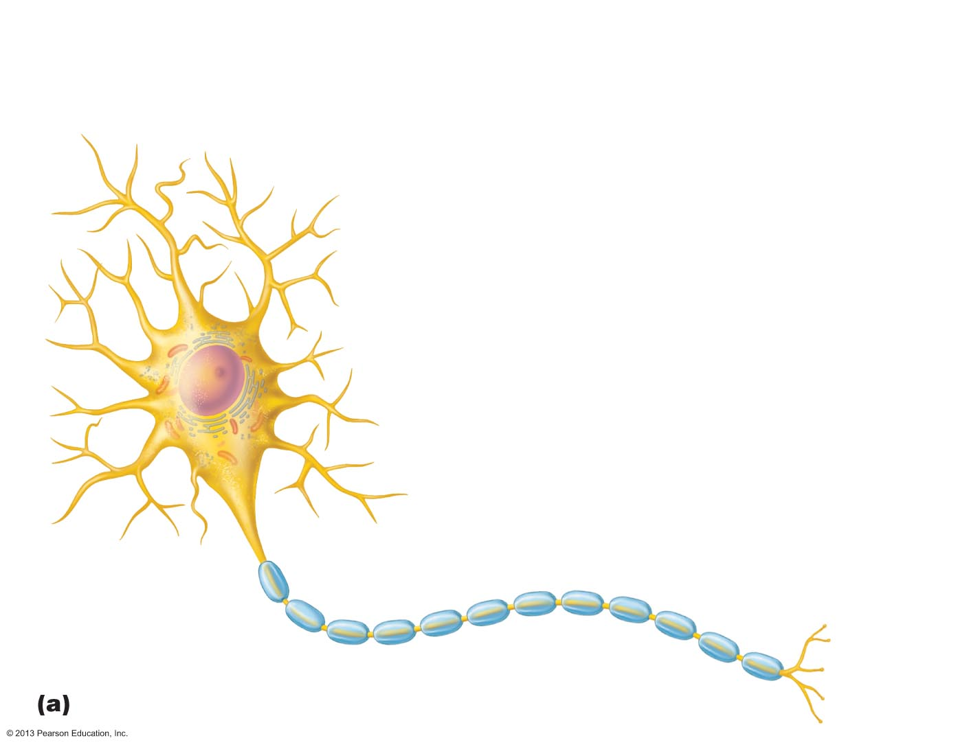
Figure 11.4a Structure of a motor neuron.
Dendrites
(receptive
regions)
Cell body
(biosynthetic center
and receptive region)
Nucleus
Axon
(impulse-
generating
and -conducting
region)
Nucleolus
Impulse
direction
Myelin sheath gap
(node of Ranvier)
Chromatophilic
substance (rough
endoplasmic
reticulum)
Axon
terminals
(secretory
region)
Schwann cell
Axon hillock
Terminal branches

Slide 26
Dendrites
In motor neurons
  100s of short, tapering, diffusely branched processes
  Same organelles as in body
Receptive (input) region of neuron
Convey incoming messages toward cell body as graded potentials (short distance signals)
In many brain areas fine dendrites specialized
  Collect information with dendritic spines
    Appendages with bulbous or spiky ends

Slide 27
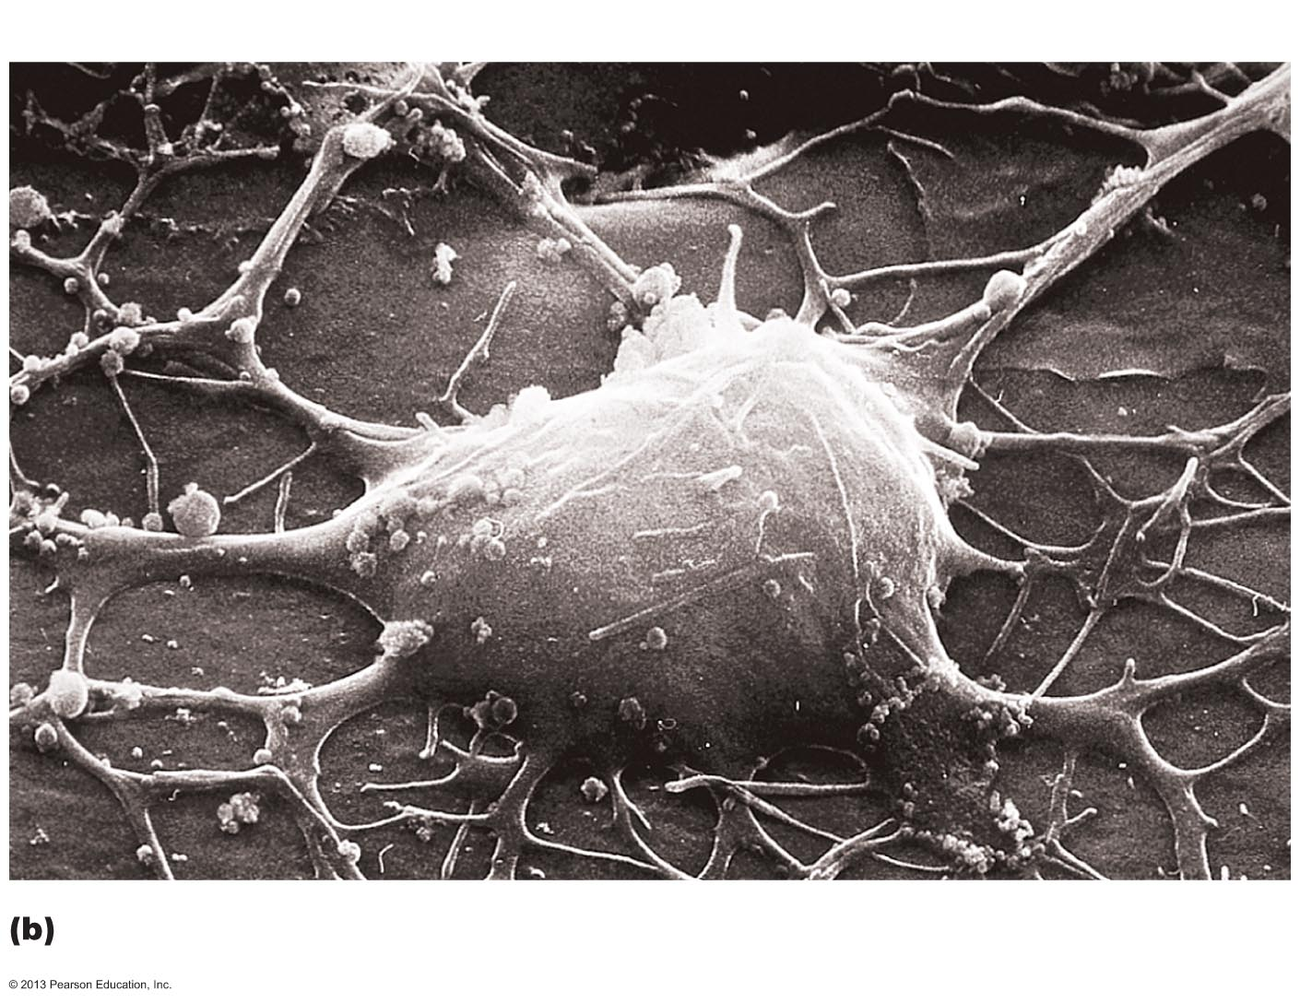
Figure 11.4b Structure of a motor neuron.
Neuron cell body
Dendritic
spine

Slide 28
The Axon: Structure
One axon per cell arising from axon hillock
  Cone-shaped area of cell body
In some axon short or absent
In others most of length of cell
  Some 1 meter long
Long axons called nerve fibers
Occasional branches (axon collaterals)
Branches profusely at end (terminus)
Can be 10,000 terminal branches
Distal endings called axon terminals or terminal boutons

Slide 29
The Axon: Functional Characteristics
Conducting region of neuron
Generates nerve impulses
Transmits them along axolemma (neuron cell membrane) to axon terminal
  Secretory region
  Neurotransmitters released into extracellular space
    Either excite or inhibit neurons with which axons in close contact
Carries on many conversations with different neurons at same time
Lacks rough ER and Golgi apparatus
  Relies on cell body to renew proteins and membranes
  Efficient transport mechanisms
  Quickly decay if cut or damaged

Slide 30
Transport Along the Axon
Molecules and organelles are moved along axons by motor proteins and cytoskeletal elements
Movement in both directions
  Anterograde—away from cell body
    Examples: mitochondria, cytoskeletal elements, membrane components, enzymes
  Retrograde—toward cell body
    Examples: organelles to be degraded, signal molecules, viruses, and bacterial toxins

Slide 31
Myelin Sheath
Composed of myelin
  Whitish, protein-lipoid substance
Segmented sheath around most long or large-diameter axons
  Myelinated fibers
Function of myelin
  Protects and electrically insulates axon
  Increases speed of nerve impulse transmission
Nonmyelinated fibers conduct impulses more slowly

Slide 32
Myelination in the PNS
Formed by Schwann cells
  Wrap around axon in jelly roll fashion
  One cell forms one segment of myelin sheath
Myelin sheath
  Concentric layers of Schwann cell plasma membrane around axon
Outer collar of perinuclear cytoplasm (formerly called neurilemma)
  Peripheral bulge of Schwann cell containing nucleus and most of cytoplasm

Slide 33
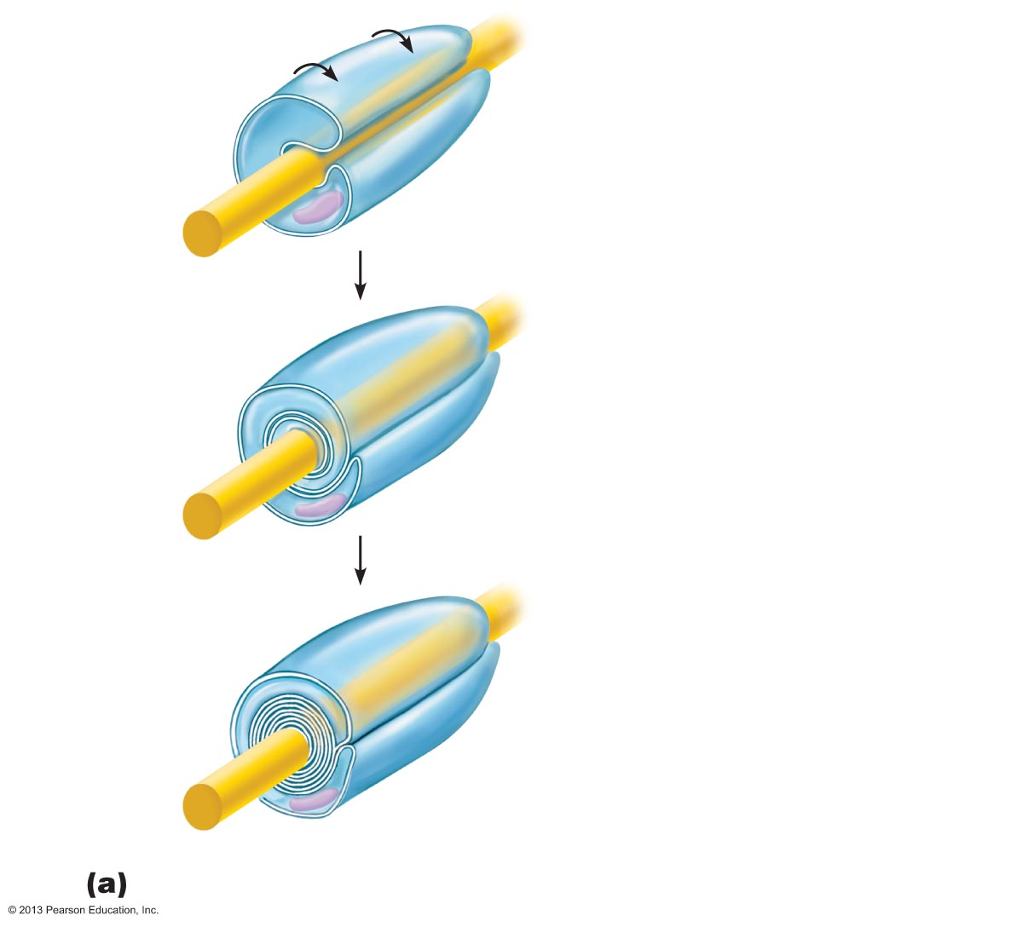
Figure 11.5a Nerve fiber myelination by Schwann cells in the PNS.
Schwann
cell plasma
membrane
Slide 1
A Schwann cell envelops an axon.
1
Schwann cell
cytoplasm
Axon
Schwann cell
nucleus
2
The Schwann cell then rotates
around the axon, wrapping its
plasma membrane loosely around
it in successive layers.
3
The Schwann cell cytoplasm is
forced from between the membranes.
The tight membrane wrappings
surrounding the axon form the myelin
sheath.
Myelin
sheath
Schwann cell cytoplasm
Myelination of a nerve fiber (axon)

Slide 34
Figure 11.5a Nerve fiber myelination by Schwann cells in the PNS.
Schwann
cell plasma
membrane
Slide 2
A Schwann cell envelops an axon.
1
Schwann cell
cytoplasm
Axon
Schwann cell
nucleus
Myelination of a nerve fiber (axon)

Slide 35
Figure 11.5a Nerve fiber myelination by Schwann cells in the PNS.
Schwann
cell plasma
membrane
Slide 3
A Schwann cell envelops an axon.
1
Schwann cell
cytoplasm
Axon
Schwann cell
nucleus
2
The Schwann cell then rotates
around the axon, wrapping its
plasma membrane loosely around
it in successive layers.
Myelination of a nerve fiber (axon)

Slide 36
Figure 11.5a Nerve fiber myelination by Schwann cells in the PNS.
Schwann
cell plasma
membrane
Slide 4
A Schwann cell envelops an axon.
1
Schwann cell
cytoplasm
Axon
Schwann cell
nucleus
2
The Schwann cell then rotates
around the axon, wrapping its
plasma membrane loosely around
it in successive layers.
3
The Schwann cell cytoplasm is
forced from between the membranes.
The tight membrane wrappings
surrounding the axon form the myelin
sheath.
Myelin
sheath
Schwann cell cytoplasm
Myelination of a nerve fiber (axon)

Slide 37
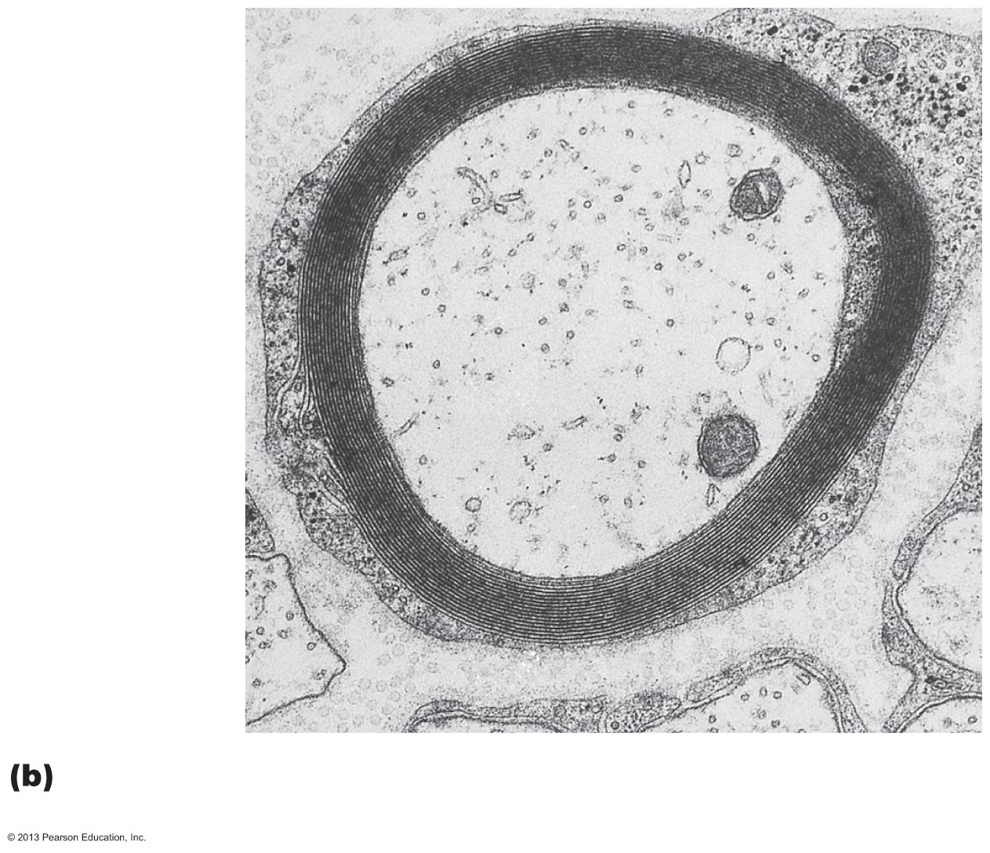
Figure 11.5b Nerve fiber myelination by Schwann cells in the PNS.
Myelin sheath
Outer collar
of perinuclear
cytoplasm
(of Schwann
cell)
Axon
Cross-sectional view of a myelinated axon (electron
micrograph 24,000x)

Slide 38
Myelination in the PNS
Plasma membranes of myelinating cells have less protein
  No channels or carriers
  Good electrical insulators
  Interlocking proteins bind adjacent myelin membranes
Myelin sheath gaps
  Gaps between adjacent Schwann cells
  Sites where axon collaterals can emerge
  Formerly called nodes of Ranvier
Myelin sheath gaps between adjacent
Schwann cells
  Sites where axon collaterals can emerge
Nonmyelinated fibers
  Thin fibers not wrapped in myelin; surrounded by Schwann cells but no coiling; one cell may surround 15 different fibers

Slide 39
Myelin Sheaths in the CNS
Formed by multiple, flat processes of oligodendrocytes, not whole cells
Can wrap up to 60 axons at once
Myelin sheath gap is present
No outer collar of perinuclear cytoplasm
Thinnest fibers are unmyelinated
  Covered by long extensions of adjacent neuroglia
White matter
  Regions of brain and spinal cord with dense collections of myelinated fibers – usually fiber tracts
Gray matter
  Mostly neuron cell bodies and nonmyelinated fibers

Slide 40
Figure 11.3d Neuroglia.
Myelin sheath
Process of
oligodendrocyte
Nerve
fibers
Oligodendrocytes have processes that form myelin
sheaths around CNS nerve fibers.

Slide 41
Structural Classification of Neurons
Grouped by number of processes
Three types
  Multipolar – 3 or more processes
    1 axon, others dendrites
    Most common; major neuron in CNS
  Bipolar – 2 processes
    1 axon and 1 dendrite
    Rare, e.g., Retina and olfactory mucosa
  Unipolar – 1 short process
    Divides T-like – both branches now considered axons
      Distal (peripheral) process – associated with sensory receptor
      Proximal (central) process – enters CNS

Slide 42
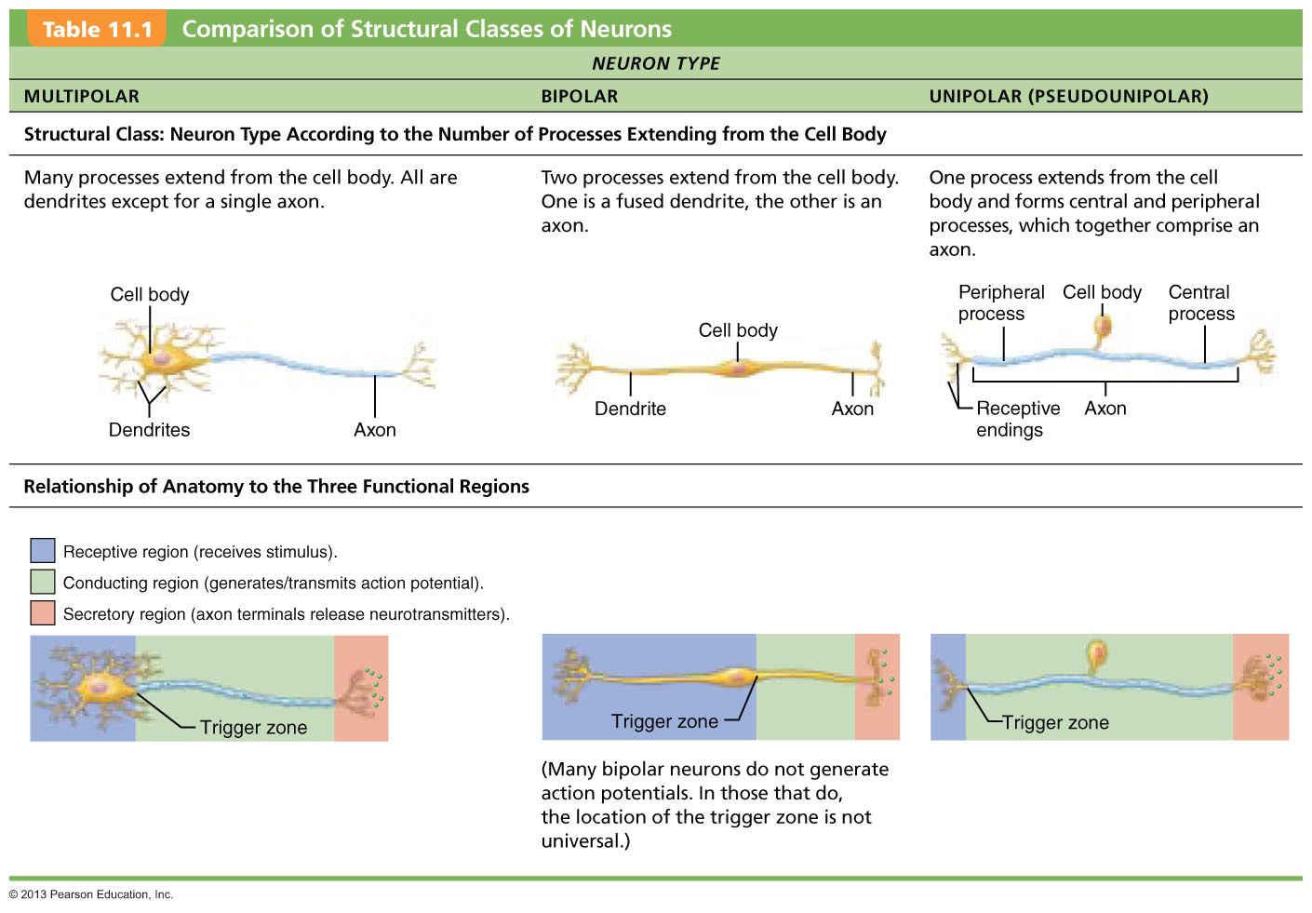
Table 11.1 Comparison of Structural Classes of Neurons (1 of 3)

Slide 43
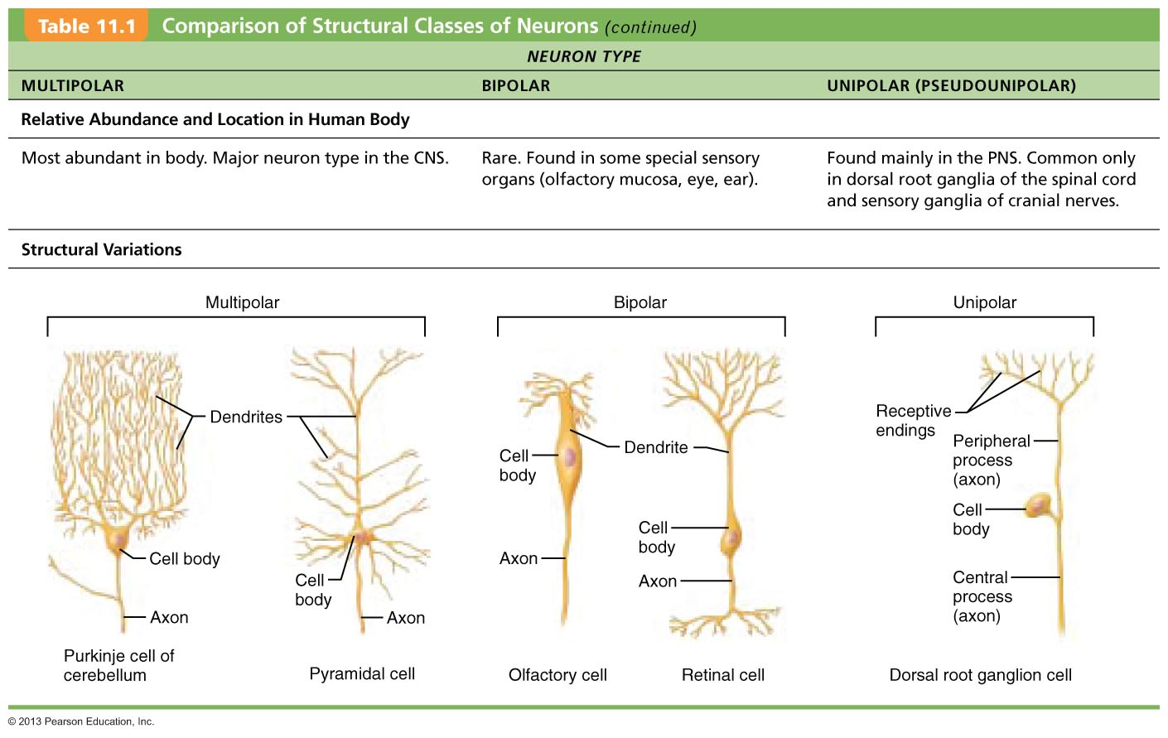
Table 11.1 Comparison of Structural Classes of Neurons (2 of 3)

Slide 44
Functional Classification of Neurons
Grouped by direction in which nerve impulse travels relative to CNS
Three types
  Sensory (afferent)
  Motor (efferent)
  Interneurons

Slide 45
Functional Classification of Neurons
Sensory
  Transmit impulses from sensory receptors toward CNS
  Almost all are Unipolar
  Cell bodies in ganglia in PNS
Motor
  Carry impulses from CNS to effectors
  Multipolar
  Most cell bodies in CNS (except some autonomic neurons)
Interneurons (association neurons)
  Lie between motor and sensory neurons
  Shuttle signals through CNS pathways; most are entirely within CNS
  99% of body's neurons
  Most confined in CNS

Slide 46
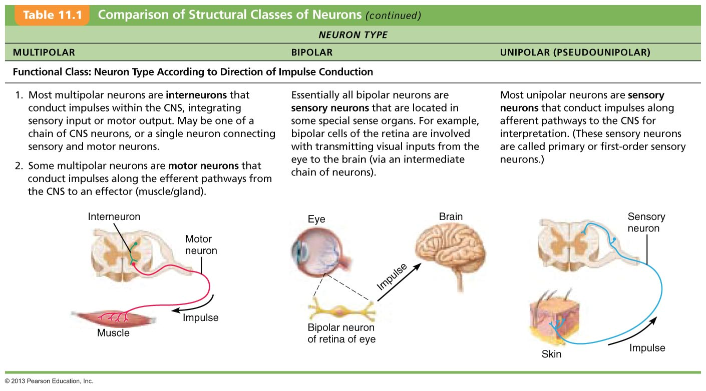
Table 11.1 Comparison of Structural Classes of Neurons (3 of 3)

